Slide 1


SOEN 6841
Intelligent Tutoring System-Learn Adapt
Anubhav Mahajan 40267770
Hardeep Singh 40304655
Muskan Gupta 40230236
Prachi Jatinkumar Patel 40261038
Theophilus McEl Amafu 40276406

Slide 2
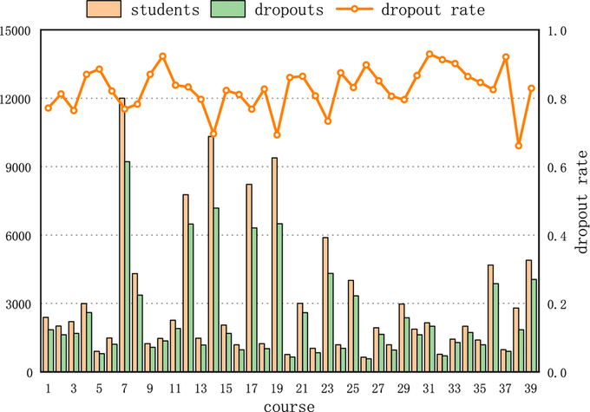

Challenges in Modern Education
Traditional and online platforms lack personalization.
MOOCs like Coursera and edX have dropout rates exceeding 80%.
Students face challenges such as delayed feedback and static content delivery.
Teachers struggle to accommodate diverse learning styles in large classrooms.
Source: https://www.researchgate.net/figure/The-number-of-students-of-dropouts-and-dropout-rates-in-different-courses_fig2_328344994

Slide 3
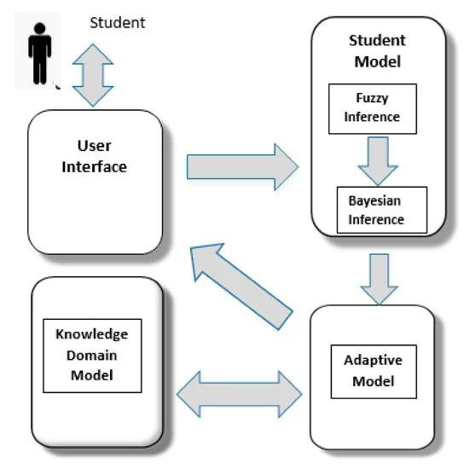
Introducing Intelligent Tutoring System (ITS)
ITS uses AI to provide personalized, real-time learning experiences.
Adapts content to individual student needs and learning styles.
Offers real-time feedback, dynamic learning paths, and gamified engagement.

Slide 4
Industry Trends and Needs
Remote Learning Surge
AI in Education
Personalization Demand
The pandemic has accelerated the need for effective online education solutions.
Growing adoption of AI technologies in classrooms to enhance teaching and learning.
Increasing recognition of the benefits of tailored learning experiences for students.
Notes:
4

Slide 5

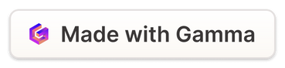
Overview of the Problem and Proposed Solution
1
Data Deluge
The exponential growth of data from various sources, including IoT devices, social media, and e-commerce platforms, has created a demand for real-time processing and analysis.
2
Limitations of Batch Processing
Traditional batch-based data processing approaches struggle to keep up with the pace of data generation, leading to delayed insights and missed opportunities.
3
Introducing Real-Time Processing
Our solution employs a highly scalable and low-latency real-time data processing engine, enabling organizations to unlock the full potential of their data assets.
Notes:
5

Slide 6
Why ITS is Needed
Gaps in current platforms: lack of adaptive learning, real-time feedback, and personalization.
Target Groups:
Students: academic assistance, skill-building.
Professionals: upskilling, career shifts.
Institutions: improved learning outcomes.
Parents and policymakers: accessibility and inclusivity.

Slide 7
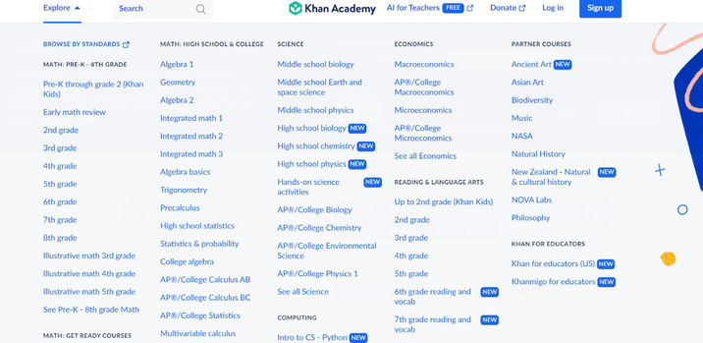
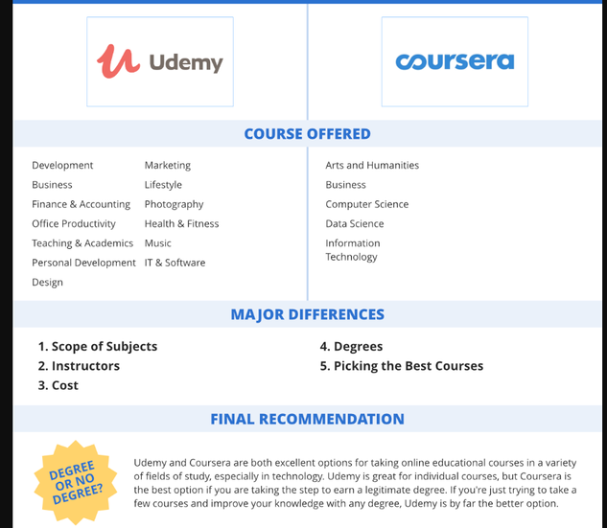
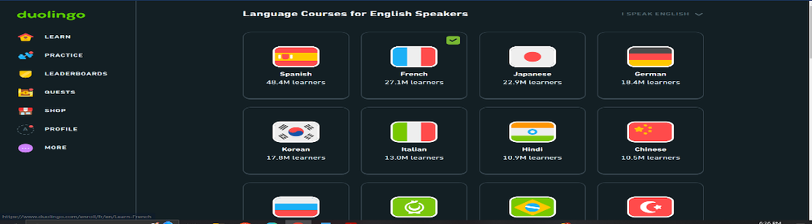
How ITS Stands Out
Khan Academy: Free content but lacks advanced adaptive features.
Coursera/Udemy: Great certifications but static learning paths.
Duolingo: Gamified, but limited to language learning.
ITS strengths: personalized learning, real-time feedback, and broad subject coverage.

Slide 8
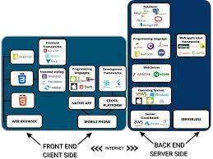
Robust Technology Stack
Machine Learning: Adaptive content recommendations.
NLP: Real-time conversational feedback.
Backend: Django + TensorFlow; Frontend: React.js.
Scalable infrastructure using AWS/Google Cloud and Docker/Kubernetes.
Source: https://www.linkedin.com/pulse/choosing-right-tech-stack-your-project-scrumlaunch-ukraine/

Slide 9


Personalized Learning Experience
Adaptive Content
Learning Style Recognition
Lessons adjust difficulty based on student performance and comprehension levels.
AI identifies and caters to visual, auditory, or kinesthetic learning preferences.
Real-time Feedback
Personalized Pacing
Immediate, constructive feedback helps students understand and correct mistakes quickly.
Students progress at their own speed, ensuring thorough understanding before advancing.
Notes:
9

Slide 10

Improved Learning Outcomes
Metric
Before ITS
After ITS
Test Scores
70%
85%
Engagement
60%
90%
Completion Rate
75%
95%
Notes:
10

Slide 11




Technical Feasibility
Scalable Architecture
Our solution is built on a highly scalable, distributed architecture that can handle growing data volumes and throughput requirements.
Low-Latency Processing
Advanced stream processing techniques ensure that data is analyzed and acted upon in near real-time, enabling rapid decision-making.
Fault Tolerance
The platform is designed with built-in fault tolerance and high availability features to ensure continuous operations and data reliability.
Notes:
11

Slide 12
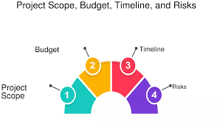
Achieving Viability
Development cost: $150,000–$200,000.
Maintenance: $10,000–$15,000/month.
ROI expected within 2-3 years due to higher retention and engagement rates.
Operational benefits: scalable, integrates with LMS like Moodle.
Source: https://fastercapital.com/topics/project-scope,-budget,-timeline,-and-risks.html

Slide 13
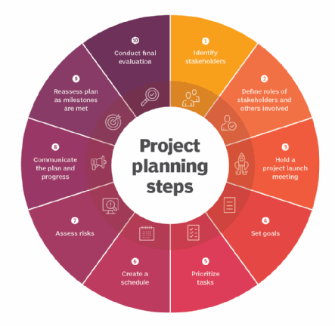
Project Roadmap
Phase 1: Research and Requirements Gathering (Weeks 1-3).
Phase 2: System Design and Architecture (Weeks 4-6).
Phase 3: Development and Integration (Weeks 7-12).
Phase 4: Testing and Deployment (Weeks 7-15).

Slide 14
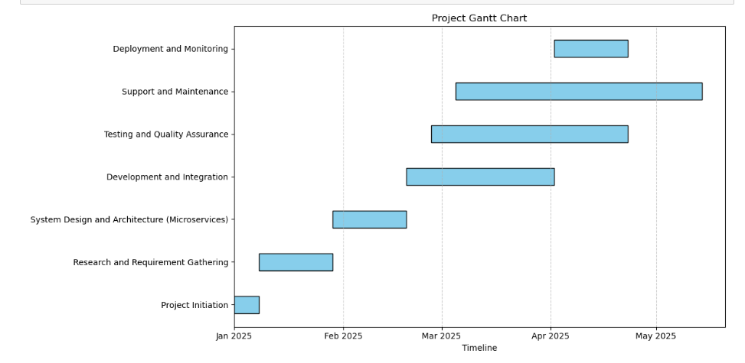
TimeLine

Slide 15
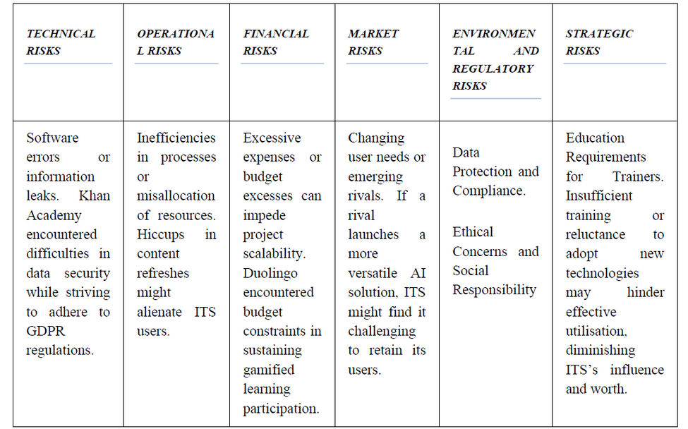
Proactive Risk Management
Encryption, multi-factor authentication for data security.
Redundant servers and automated backups for reliability.
Onboarding sessions to ease adoption.
Emphasizing ITS’s unique features in marketing.

Slide 16



Risk Mitigation and Contingency Planning
Data Security
Integration Challenges
User Adoption
Implement robust encryption and comply with data protection regulations.
Develop flexible APIs for seamless integration with existing school systems.
Provide comprehensive training and support for educators and students.
Notes:
15

Slide 17
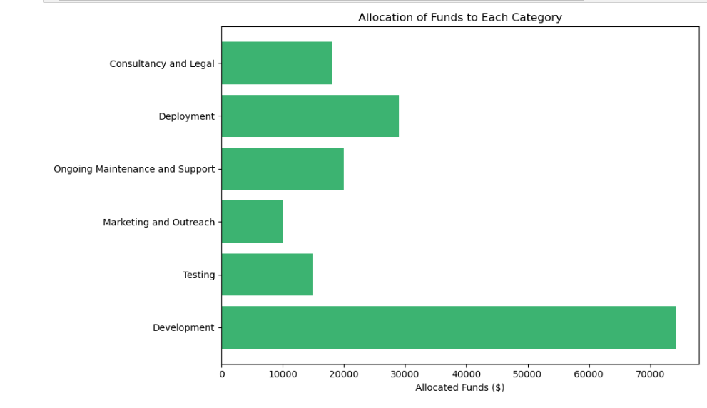
Budget Overview-Fund Allocation

Slide 18
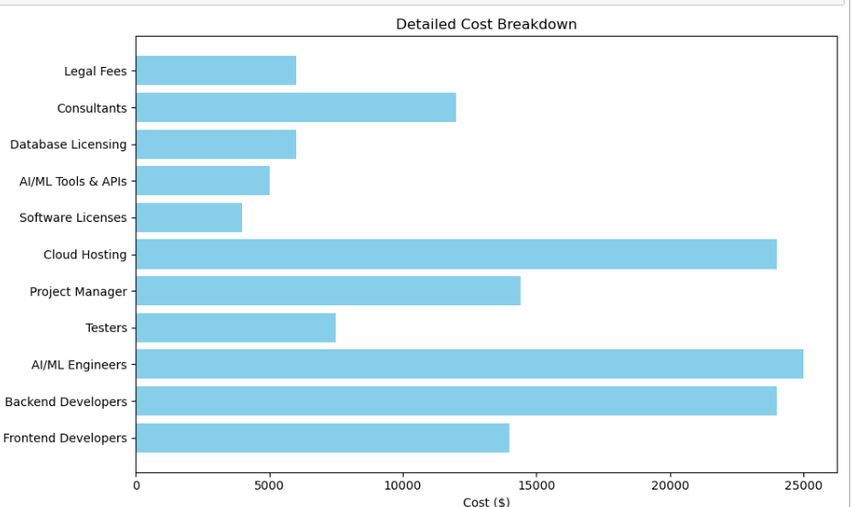
Budget Overview-Detailed Resource cost breakdown

Slide 19

The Future of Learning is Here
ITS bridges the gaps in education through personalization and real-time adaptability.
Enhances student engagement and outcomes.
Scalable and economically viable for institutions.

Slide 20
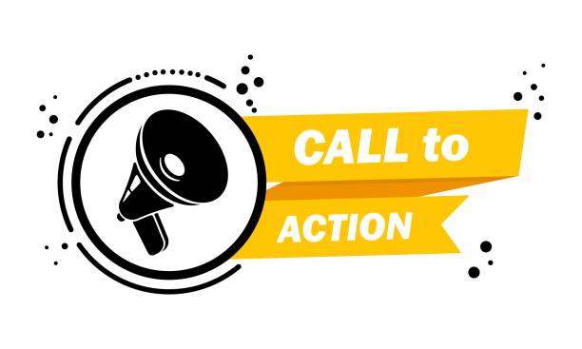
Call to Action
Pilot ITS in your institution to experience the benefits.
Collaborate with us to shape the future of education.
Let’s create a personalized, effective learning environment for everyone.

Slide 21


